Slide 1
Parent council
Thursday, January 21

Slide 2
AGENDA
1. Opening/Agenda-Saullo
2. 7 to 8—Nolan
3. 8 to 9—Nolan/Schmon
4. 9 to 10—Schmon
5. Parent Resources – Dowd

Slide 3
Program Planning
Grade 7 to Grade 8
Important dates
Core subject info
Elective considerations

Slide 4
Rising 8th graders
Jan 27/28 – Assembly overviewing academic and elective courses
Jan 28 – Eligible students select French or Spanish in ELA classes
Feb 5-11
    Acknowledge/Verify Courses in portal
    Students must Complete Forms survey to request changes

Slide 5
CoRE SUBJECTS offered as Academic, honors, special education
ELA
-Integrates reading, writing, research and speech rhetoric
-In forms of short stories, novels, poetry, dramas and film
Science​
  -Focuses on Matter, Forces and Motion, Astronomy and the Human body
Social Studies​
  -Covers US History from 17th century through 19th century
World Language/Reading 8​
  -Spanish 1 or French 1
Notes:
ENG- Many texts will be covered over the year in forms of short stories, novels poetry, dramas and film . A staple is the Outsiders novel. Keep in mind one of the transitions for students 7th to 8th is they go from two ELA blocks to one 50 min.
Science- students recommended for ADV will be required to complete a challenging scientific investigation focusing on the important role of the scientific method in the analysis of a problem. This requirement will take a large chunk of the year and is also an independent project.
SS- students recommended for ADV will be required to complete an extensive research project. You'll note both ADV SCI and SS both have independent projects, although is taking both is permitted it is not encourages. If your family has outside school commitments this will be something to consider. We reqest your child choose one ADV level b/ of the rigor of these courses and the simultaneos demands of the courses
World Languages- the goal of the 8th grade language courses is to use fundamental expressions and vocab. Allow your child to be exposed to another language and their culture.

Slide 6
CoRE SUBJECTS
MATH
-Geometry/Trigonometry​
-Algebra 1
-Algebra 1​B
-Algebra 1A​
-Pre- Algebra
-Math 8
Notes:
Most 7th graders are in Pre-Alg and when moving to Alg 1 there is a 90% cusp pre-req. But teacher recommendation is considered in determining Alg 1 vs. Breakdown of Alg 1A and 1B.

Slide 7
Electives
Health/ PE​ | Music​ | Art​/Pen | Tech Ed | Family & Consumer Science ​ | Integrated Tech
Health/PE 8 | Band 8 Chorus 8 Orch 8 Expl. Music | Modern Art & Design * PEN | Princ of Engr | FCS 2 | Integrated Tech 2
If your student is in a performing arts music they will be scheduled for IT, PE and 2 of the other 3 electives they didn’t have this year (Art, FCS and Tech Ed).
If your student is non -performing they take ALL electives listed above over the course of the year.
Notes:
Autoload students whom are NOT Band/Chorus/Orch they must take Expl Music. Including if they drop out at any point in the year.
Don’t take both ADV SCI/SS- two LARGE independent projects that occur at the same time. Feedback from parents and students that it is a lot if a student has other activities and commitments. I also say to students though if Academics is your sport – then go for it!
If your child is not recommended for ADV- indicate on the sheet that you are interested in ADV and we will ask at MP4. Please try and communicate on the verification the recommendation you are anticipating if different then what's listed.

Slide 8
Program Planning
Grade 8 to Grade 9
Important dates
Core subject info
Elective considerations

Slide 9
Rising 9th graders
Jan 28 – Assembly overviewing academic and elective courses
Feb 1-2 – Students choose and enter electives during resource with Guidance
Feb 23-Mar 2
    Acknowledge/Verify Courses in portal
    Students must Complete Forms survey to request changes

Slide 10
CoRE SUBJECTS offered as Academic, honors, special education
ELA
-Integrates reading, writing, researching, speaking
-Romeo & Juliet, To Kill a Mockingbird, Night
Science
-Primarily Earth Science
Social Studies
-American History 1890 to Present
World Language/Reading 9/Study Skills
-Spanish or French

Slide 11
CoRE SUBJECTS
Math
-Honors Alg. 2/Trigonometry
-Geometry/Trigonometry
-Algebra 1
-Algebra 1B
-Algebra 1A
-Math 9

Slide 12
Electives
.25 credits or .50 credits
Health/PE (.50)- ALL STUDENTS TAKE | Music | Art (.25) | Tech Ed (.25) | Family & Consumer Science (.25) | Integrated Tech (.25)
Health/PE 9 | Band 9 (.50) | Drawing & Painting | Engineering & Design | Sewing | Technology & App Development
 | Chorus 9 (.50) | Ceramics | Technical Drawing & Design | Cooking
 | Orchestra 9 (.50) | Photography | Engineering Processes
 | Guitar 9 (.25) | 3D Design
* PEN 9 (.25) also available
* Must add up to 1.50 credits

Slide 13
Program Planning
Grade 9 to Grade 10
Important dates
Core subject info
Elective considerations

Slide 14
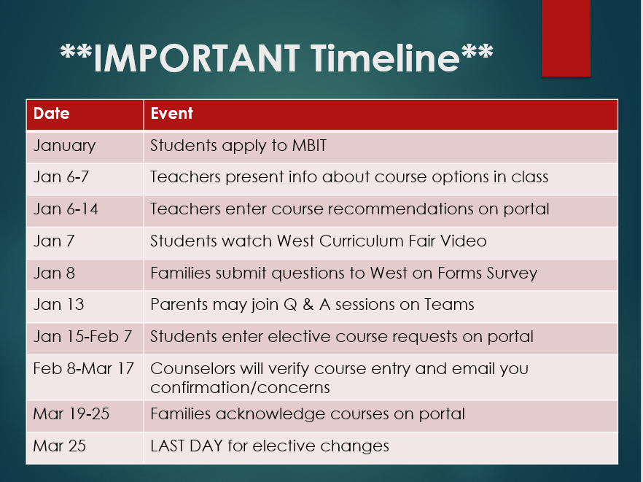
Rising 10th graders

Slide 15

West Curriculum Fair!
https://www.cbsd.org/cbwest

Slide 16
All students must Enroll in:
BIOLOGY (Keystone course)
MATH
ENGLISH
SOCIAL STUDIES
PE/HEALTH (Except MBIT)

Slide 17
Considerations for High school courses
Can be very overwhelming
Challenge, not overload
Try new things!
Consider alternates carefully
World Language
New Courses

Slide 18
Block Scheduling
Marking Period 1
Marking Period 2
Marking Period 3
Marking Period 4
Per 1
90 min
English
Math
Per 2
90 min
Biology
Social Studies
Per 3
90 min
+ 30 min lunch
PE
Web Design
World Language
Per 4
90 min
Art 1
Journalism
Global Gourmet
Each block is worth .5 credits
A major subject = 1 full credit = 2 blocks side by side everyday
A course that =. 5 credits = 1 block every day
Notes:
Gym…. You’ve taken it and now you are done FOREVER! You can also take more if you’d like.

Slide 19
Block Scheduling
Marking Period 1
Marking Period 2
Marking Period 3
Marking Period 4
Per 1
90 min
English
Math
Per 2
90 min
Biology
Social Studies
Per 3
90 min
+ 30 min lunch
Oceanography
Intro to Law
World Language
Per 4
90 min
AP European History
PE
AP History = 1.5 Cr = 3 blocks side by side every day

Slide 20


Block Scheduling
Marking Period 1
Marking Period 2
Marking Period 3
Marking Period 4
Per 1
90 min
English
Math
Per 2
90 min
Biology
Social Studies
Per 3
90 min
+ 30 min lunch
Intro to Film
Personal Finance
World Language
Per 4
90 min
Notes:
If you’re in music you run still on an AB schedule. And it is a YEAR long commitment.

Slide 21
Sample Schedule
Marking Period 1
Marking Period 2
Marking Period 3
Marking Period 4
MBIT
English
Math
Biology
History
MBIT students – assuming MBIT is in all 3 grades 10, 11, 12
Need only their grade 9 PE .5 credit (all year every other day)
Notes:
MBIT students do not have to take PE. If you drop it though- you still have to make it up then.

Slide 22
End of Year Considerations
Level Changes revisited
End of Marking period 3
End of Year; Prerequisite check
Parent Override

Slide 23
How to access information
Guidance Page on Lenape site
Lenape Schoolwide Canvas Course

Slide 24
Parent Resources
Smoke Signals Newsletter – parent information
Morning Announcement emails – student information
Canvas Notifications

